Slide 1
Date & Time in JavaScript
front.jit #4 (15.11.2022)

Slide 2

Today’s agenda
Date & Time
Intl
Libraries

Slide 3

Date & Time

Slide 4
Date initialization
new Date(0);
new Date(24 * 60 * 24);
new Date("October 13, 2014 11:13:00");
new Date("2022-03-25"); // between March 24 and March 25
new Date("2022-03"); // between February 28 and March 01
new Date("2022"); // between December 31 and January 01
new Date("2022-11-15T12:00:00Z"); // UTC
new Date("2022-3-25"); // ⚠️

Slide 5
Date initialization
new Date(year,month)
new Date(year,month,day)
new Date(year,month,day,hours)
new Date(year,month,day,hours,minutes)
new Date(year,month,day,hours,minutes,seconds)
new Date(year,month,day,hours,minutes,seconds,ms) new Date(2018, 11, 24, 10, 33, 30, 0); // it’s December new Date(2018, 15, 24, 10, 33, 30) == new Date(2019, 3, 24, 10, 33, 30) // 🤯

Slide 6
Getters
getDate() – getting day numer 🤯
getMonth() – get month number (counted from 0) 🤯
getDay() - get weekday numer (counted from 0) 🤯
getFullYear() // yyyy
getHours() // (0-23)
getMinutes() // (0-59)
getSeconds() // (0-59)
getMilliseconds() // (0-999)
getTime() // milliseconds since January 1, 1970
getUTC…
DDD?
Date Driven Development 🤣

Slide 7
Getters
toDateString() // 'Tue Nov 15 2022'
toISOString() // '2022-11-15T15:42:14.203Z'
toJSON() // '2022-11-15T15:42:14.203Z'
toLocaleDateString() // ’15/11/2022’
toLocalTimeString() // ‘16:42:14’
toString() // 'Tue Nov 15 2022 16:42:14 GMT+0100 (Central European Standard Time)'
toTimeString() // '16:42:14 GMT+0100 (Central European Standard Time)'
toUTCString() // 'Tue, 15 Nov 2022 15:42:14 GMT'

Slide 8
Setters
setDate()
setFullYear()
setHours()
setMilliseconds()
setMinutes()
setMonth()
setSeconds()
setTime()
setUTC…
MUTABILITY 🤮

Slide 9
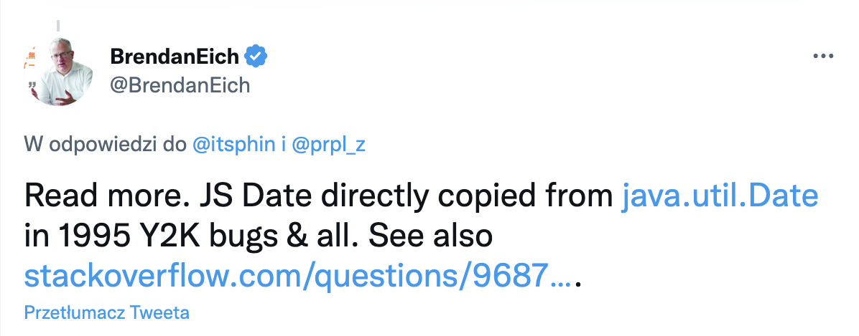
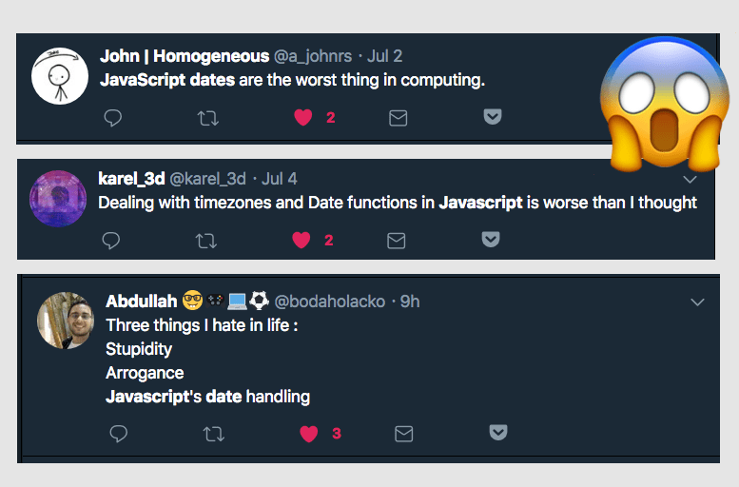
Date object is broken
Javascript was written in 10 days
It gets event worse: https://codesandbox.io/s/date-time-broken-date-object-samples-tw9zyt?file=/src/App.tsx
Why not fix the Date object?

Slide 10
Temporal
Answer for broken Date object
More straightforward API to working with both for time, as well as for dates
Intuitive naming convention („Plain” / „Zoned”)
Utility methods, e.g. add, subtract, since, until, equals, with, round, compare
Data types, e.g. Duration, TimeZone, Calendar
⚠️ Experimental – don’t use it production!
@js-temporal/polyfill

Slide 11

General advices (front-end vs back-end)
Backend should store UTC ISO timestamp (but it depends, e.g. birth date, flight times)
Frontend should store Date object (just format if needed)

Slide 12

Intl

Slide 13
Intl
ECMAScript Internationalization API
Basing on from the user is accessing the application
Currencies and numbers formating
Date and time formatting https://codesandbox.io/s/intl-samples-mw982c?file=/src/App.tsx
And a lot of more… https://egghead.io/blog/understanding-the-intl-javascript-api

Slide 14
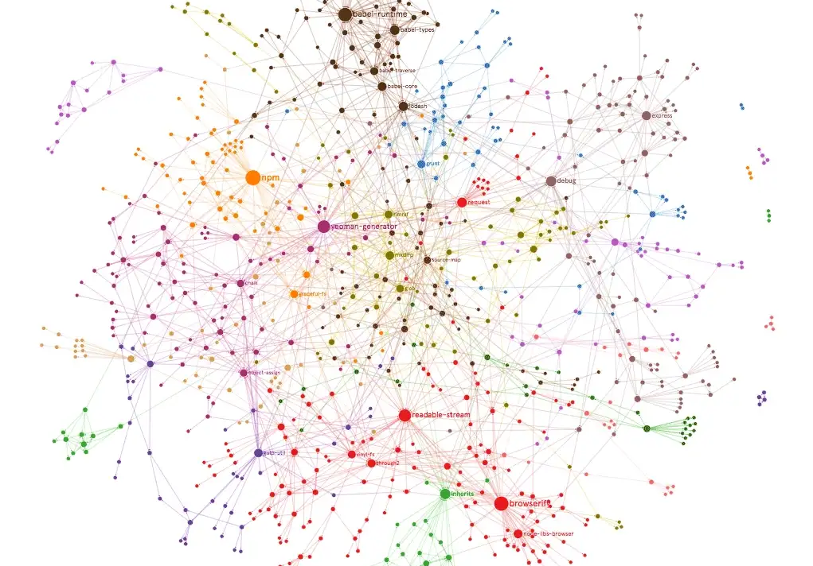
Libraries

Slide 15
Libraries
moment | dayjs | date-fns | luxon | spacetime
47k ⭐️ | 41k ⭐️ | 30k ⭐️ | 13k ⭐️ | 3.7k ⭐️
Biggest bundle (70kb) | 2kb | 20.4 kb | 18 kb | 40kb
Mutable, Maintenance mode | Immutable, chainable | Immutable, Typescipt support | Immutable, uses Intl API, months are 1-indexed | Immutable, zero deps (no Intl API), Moment-like API
format(), add(), isBefore() | format(), add(), isBefore() | format(), formatDistance(), formatRelative() | isValid(), locale(), tz() | goto(), isAsleep(), hemisphere(),
Date Pickers?
No libraries at all?

Slide 16
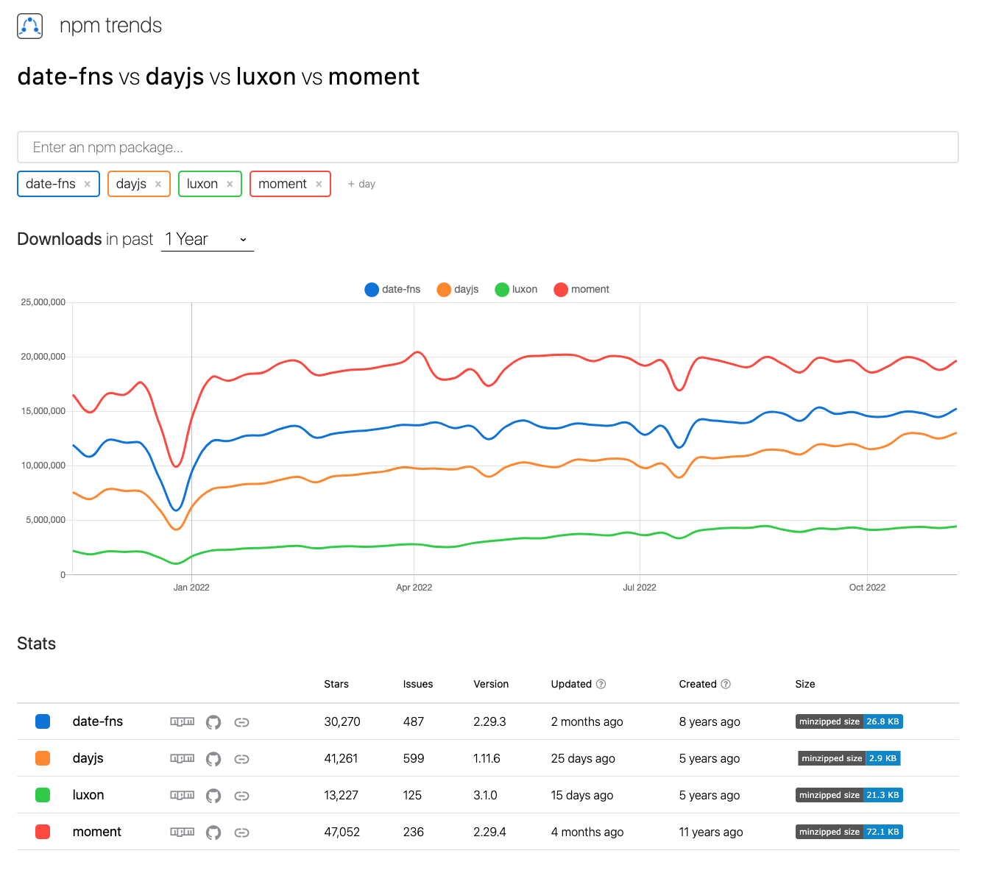
Libraries
Source: https://npmtrends.com/date-fns-vs-dayjs-vs-luxon-vs-moment

Slide 17
References
Date & Time:
https://www.w3schools.com/jsref/jsref_obj_date.asp
https://maggiepint.com/2017/04/09/fixing-javascript-date-getting-started/
https://hackernoon.com/dates-in-javascript-are-broken-who-shall-fix-them
https://tc39.es/proposal-temporal/docs/cookbook.html
https://vladmihet.hashnode.dev/temporal-api-javascript-dates-but-better
https://blog.webdevsimplified.com/2022-02/temporal-date-api/
Libraries:
https://npmtrends.com/date-fns-vs-date.js-vs-day.js-vs-luxon-vs-moment
Intl:
https://developer.mozilla.org/en-US/docs/Web/JavaScript/Reference/Global_Objects/Intl
https://www.amitmerchant.com/human-readable-date-difference-in-javascript/
https://egghead.io/blog/understanding-the-intl-javascript-api

Slide 18
Date & Time in JavaScript
front.jit #4 (15.11.2022)

